Slide 1


Announcements
ASEN 3728 Aircraft Dynamics
UNIVERSITY OF COLORADO BOULDER

Slide 2
Announcements April 24th
W8 OR P4 due next Monday
FCQs and TA feedback form due next Tuesday
See Canvas Announcement for Details
2 Purposes: Used for evaluating faculty, improving teaching and courses
Constructive feedback is very helpful! What helped you learn the most?

Slide 3
Announcements April 22nd
W8 OR P4 due next Monday
FCQs and TA feedback form due next Monday
I will send canvas announcement with details
2 Purposes: Used for evaluating faculty, improving teaching and courses
Constructive feedback is very helpful! What helped you learn the most?
Mistake in frequencies on W7

Slide 4
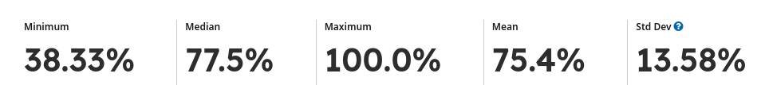
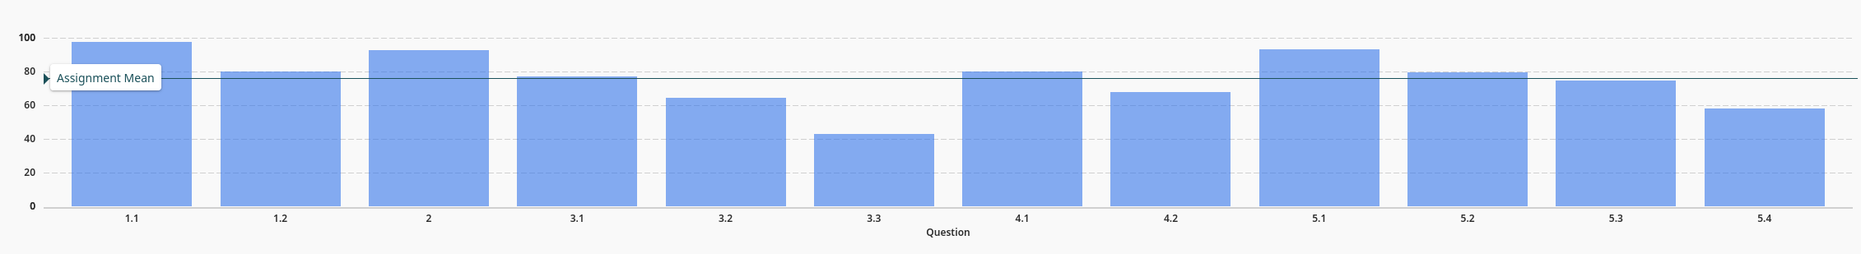
Announcements April 17th
W7 Due Friday (one extra day)
Exam 2 Grades Released

Slide 5
Announcements April 15th
W7 Due Friday (one extra day)

Slide 6
Announcements April 8th
W6 Due Friday (one extra day)

Slide 7
Exam 2
Please leave an empty seat between you and your classmates
Please do not open the exam yet;
There are 5 questions. You will write all your answers on the answer sheet.
At 1:00, you will sign the exam. You will start at 1:01
Exam will end at 2:16
Good Luck!
Turn in: Questions in LEFT box | Answer sheet on RIGHT box
Keep your equation sheet
If you used extra paper, make sure to write your name on it and staple it to the answer sheet.

Slide 8
Welcome to Exam 2
Please leave an empty seat between you and your classmates
Please do not open the exam yet;
Only solar powered calculators allowed
At 1:00, you will sign the exam. You will start at 1:01
Exam will end at 2:16
Good Luck!
Happy April Fool’s Day – the exam is Thursday 😉

Slide 9
Announcements March 20
- Exam 2: Thursday after Spring Break
- Will cover up to Longitudinal Control (finished today)

Slide 10
Announcements March 18
W5 due Friday
Exam 2: Thursday after Spring Break
While you should not simply copy the output for homework Large Language Models (AI) can be useful to address gaps in your understanding!

Slide 11
Announcements March 13
P3 Due Thursday
Use the #homework-p3 slack channel
Make sure that you submit all files
Make sure that the autograder runs
Submitting by dragging and dropping rather than zipping makes it easier for the TAs, but this is not required.
W5 Released, due next Thursday

Slide 12
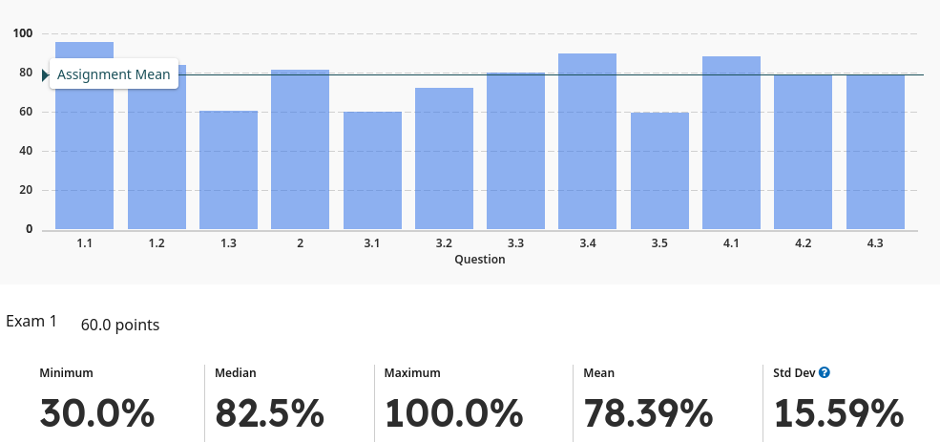
Announcements March 11
Exam 1 Grades released
If the TAs missed something, please file a regrade request, but we will regrade that problem and your grade could go down. See syllabus for time limit on regrade requests.
P3 Due Thursday
Use the #homework-p3 slack channel
Make sure that you submit all files
Make sure that the autograder runs
Submitting by dragging and dropping rather than zipping makes it easier for the TAs, but this is not required.
If you did not submit report.pdf for P2, but did everything else, we’re giving you the opportunity to resubmit it to gradescope by 11:59 Wednesday (The 10% late penalty will apply). If you run into issues, please email Connor and Kelvin.
Overleaf is here! (https://oit.colorado.edu/software-hardware/software-catalog/overleaf/overleaf-commons)

Slide 13
Announcements Feb 27
W4 Released, Due Next Thursday
Try a problem tonight :)
Next week: Guest Speaker Mark Boyer
P2 Leaderboard

Slide 14
Exam 1
Please leave an empty seat between you and your classmates
Please do not open the exam yet;
There are 4 questions. You will write all your answers on the answer sheet.
At 1:00, you will sign the exam. You will start at 1:01
Exam will end at 2:16
Good Luck!
Turn in: Questions in LEFT box | Answer sheet on RIGHT box
Keep your equation sheet

Slide 15
Announcements Feb 20
P2 due Friday, (late due date Sunday)
Need control systems toolbox for ss, initial, evaluate with wind
If you have trouble with this, can use ODE45
Exam 1 next Tuesday
Exam Review Monday at 6pm (location announced on Canvas)

Slide 16
Announcements Feb 17
W2, P1 grades released on gradescope
P2 due Friday, (late due date Sunday)
Exam 1 next week (more on this mid-class)

Slide 17
Announcements Feb 13
If you received an email from Kelvin about P1, please respond by 11:59 pm tonight (you will lose credit if you do not)
W3 Due tonight
P2 Released, due Friday 2/21, but late due date is still 2/23
Part 1 Notes released in Materials -> lecture notes
W2 Solutions Released

Slide 18
Announcements Feb 11
HW W3 Due Thursday
HW P2 Released Soon

Slide 19
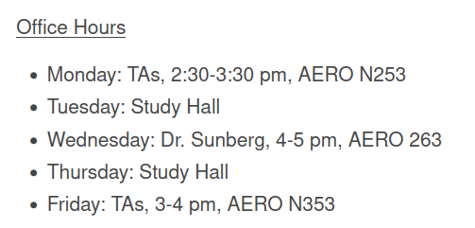
Announcements Feb 6th, 2025
Homework W2 – due Today
Homework W3
Additional Office Hours on Canvas (start next week)

Slide 20
Announcements Feb 4th, 2025
Homework W1 grades released (regrades until 2/18). Solutions in Files -> Solutions
Homework W2 – due Thursday
Homework P1 Leaderboard
Additional Office Hours TBA Soon

Slide 21
Announcements Jan 30, 2025
New Exam Dates on the Schedule
Wiki linked to on canvas
Homework W1 is 97% graded
Homework P1 due midnight tonight
Homework W2 released – due next Thursday
Study Hall tonight (T/Th 5:30-7pm) N240

Slide 22
Announcements Jan 21, 2025
Follow the link in the announcement to join the slack
Homework W1 due Thursday Saturday
Office Hours: 4-5 pm Wednesday (also this Friday only 1-1:30 pm)
Study Hall tonight (T/Th 5:30-7pm) N240

Slide 23
Announcements Jan 16, 2025
Discussions: Slack!
Reminder: Homework W1 due next Thursday
I-Clicker Quizzes start today (today’s will not count for a grade; scoring will start Tuesday)
Office Hours: 1 PM Friday starting NEXT WEEK

